Slide 1

Programming by Arduino
Team F
Instructor: Mr.Than

Slide 2
MEMBERS
NGUYỄN GIA KHÁNH
ĐỖ KHANG
NGUYỄN MINH HIẾU

Slide 3
OUTLINE
What is something called “Arduino” ?
Reason why we change to use Arduino instead of STK600
Arduino at a glance
How to connect Arduino to PC ?
Install driver and Arduino IDE on Windows
Connect to the PC
Some ideas about programming …
From the theory … to the application in our project code

Slide 4
ARDUINO
Beginners: Arduino
Intermediators: STK200
Specialists: STK500 and STK600

Slide 5
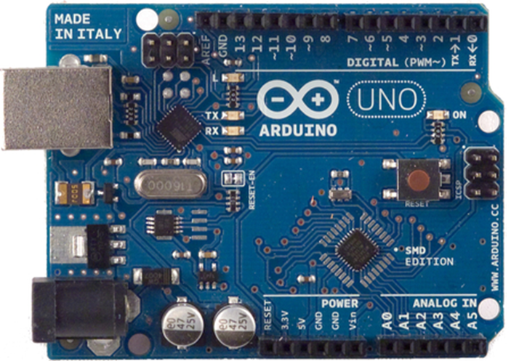
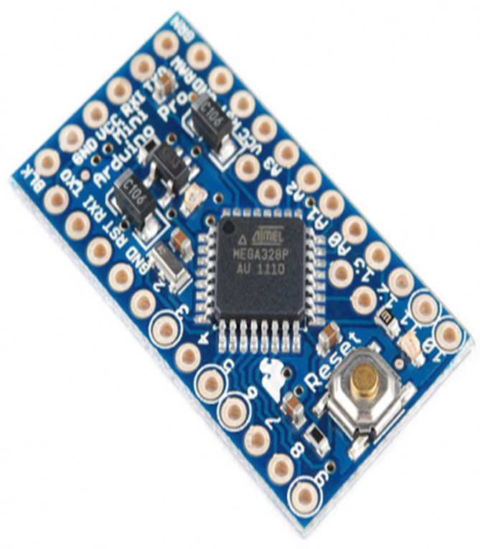
ARDUINO

Slide 6
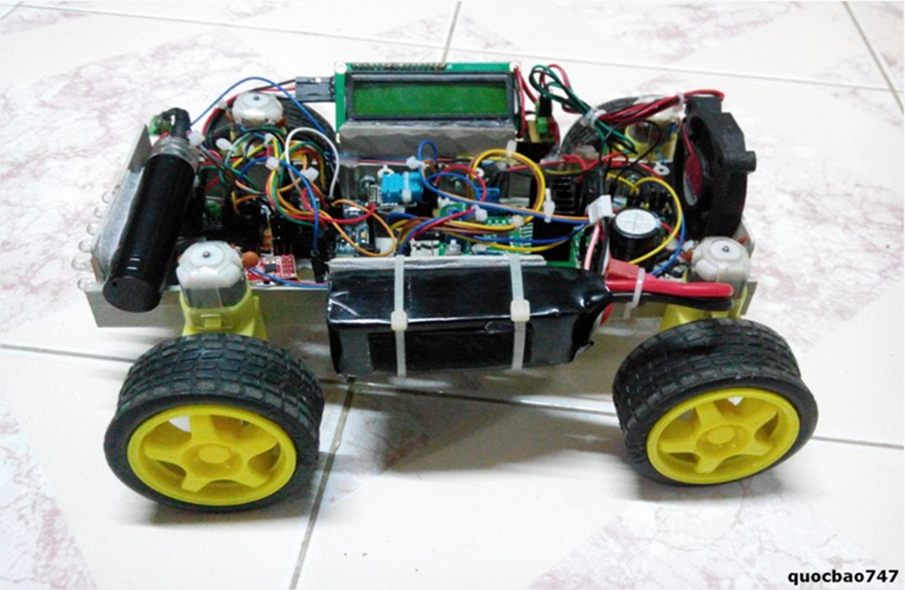
ARDUINO
“Tôi cảm thấy thật may mắn khi trên đời này có thứ gọi là Arduino”
Nguyễn Quốc Bảo – the owner of the project “Smart house“
Making next Santabot using
Arduino – Why not ?

Slide 7
ARDUINO
An open-source computer hardware and software project
User community that designs and manufactures kits for building digital devices and interactive objects that can sense and control the physical world.
Based on a family of microcontroller board designs manufactured primarily by SmartProjects in Italy, and also by several other vendors, using various 8-bit Atmel AVR microcontrollers or 32-bit Atmel ARM processors

Slide 8
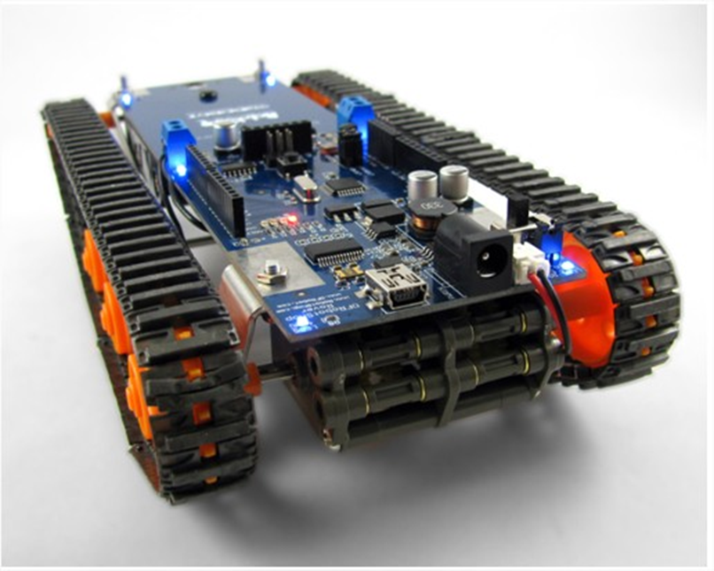
Or even this

Slide 9
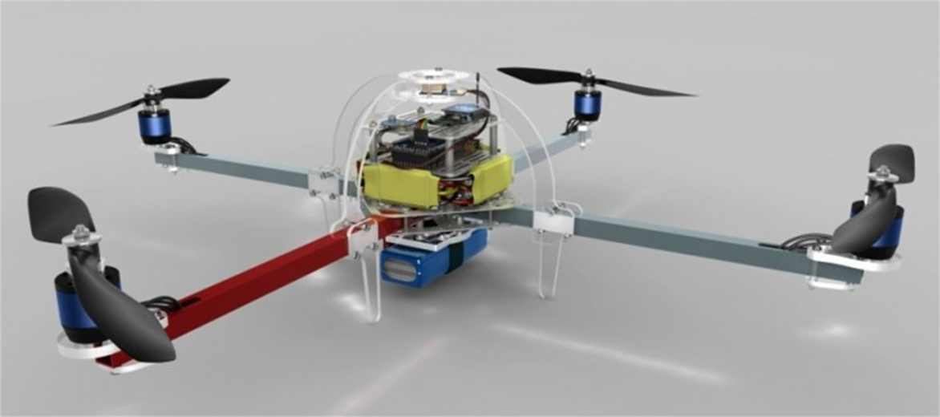
ARDUINO
And this …
Who told that you
cannot ?

Slide 10
CONNECTING TO PC
Install necessary software:
Arduino IDE: http://arduino.cc/en/Main/Software/
Driver for PC: http://arduino.cc/en/Main/Software/
(Optional) Proteus: http://www.labcenter.com/download

Slide 11
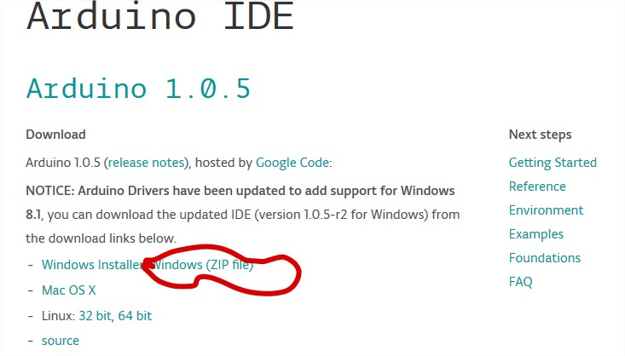
ARDUINO IDE
Step 1: Download from http://arduino.cc/en/Main/Software/

Slide 12
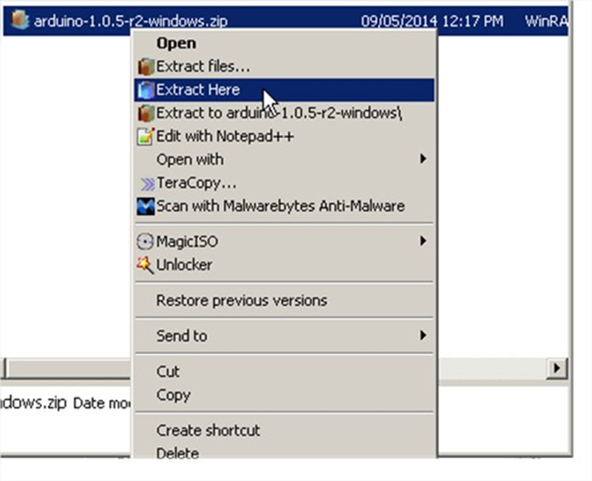
ARDUINO IDE
Step 2: Extract the downloaded file

Slide 13
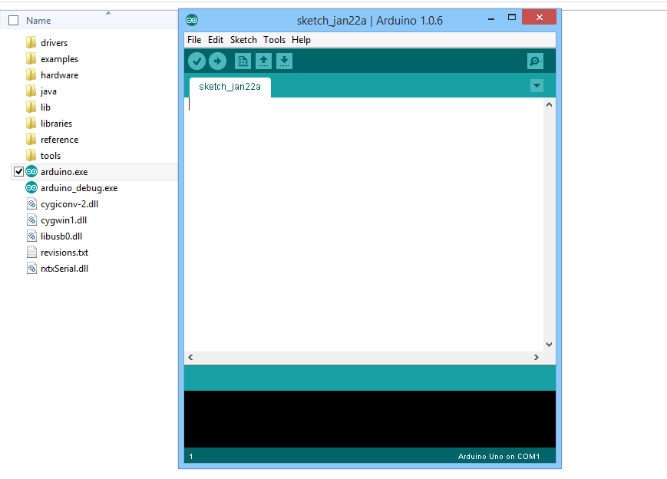
ARDUINO IDE
Step 3: Run “Arduino.exe” file

Slide 14
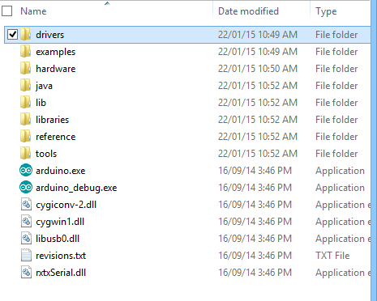
DRIVER
Step 1: Open “drivers” folder from the downloaded file

Slide 15
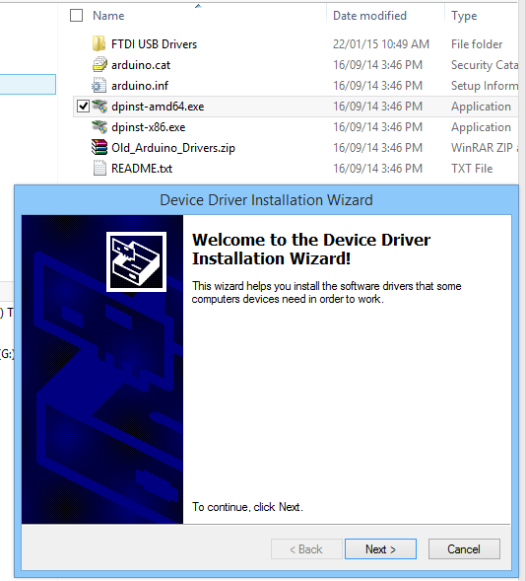
DRIVER
Step 2: Run suitable setup file

Slide 16
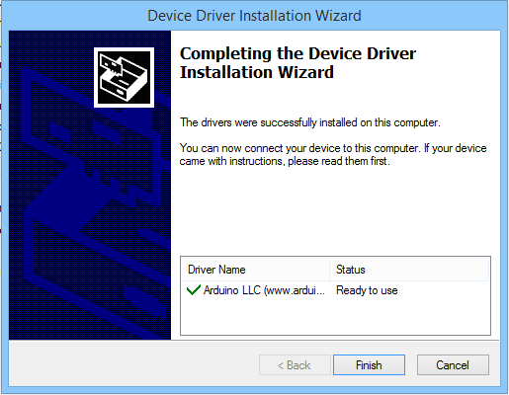
DRIVER
Step 3: Following the installation Wizard until you finish

Slide 17
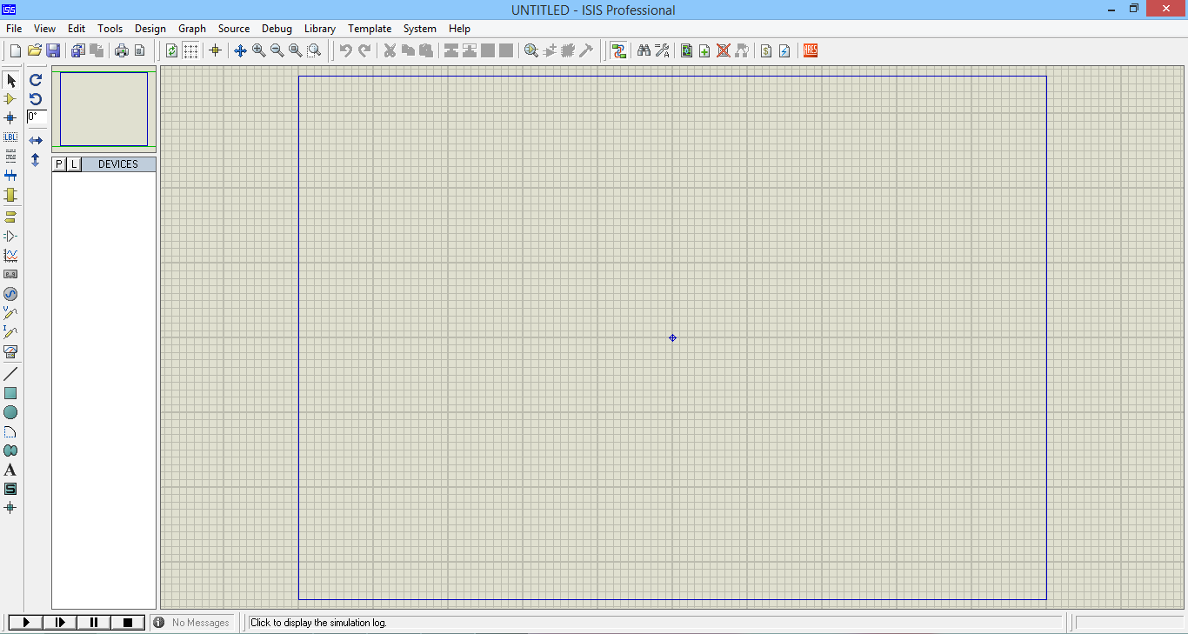
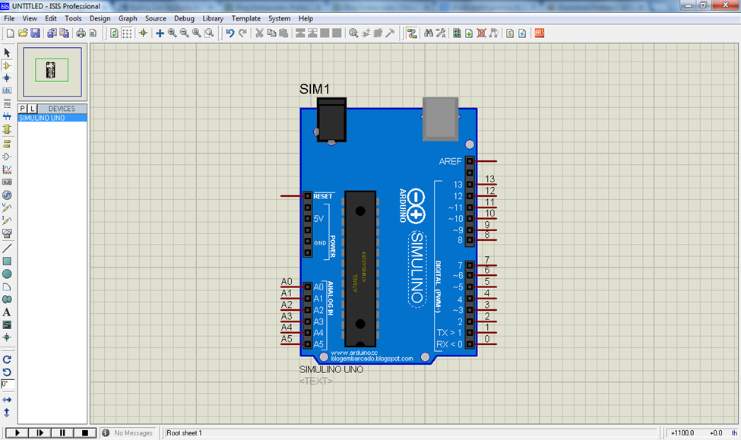
PROTEUS (CIRCUIT SIMULATION)

Slide 18
CONNECTING TO PC
b) Plug the USB gate to the PC from the Arduino circuit

Slide 19
SOME PROGRAMMING IDEAS
From theory …

Slide 20
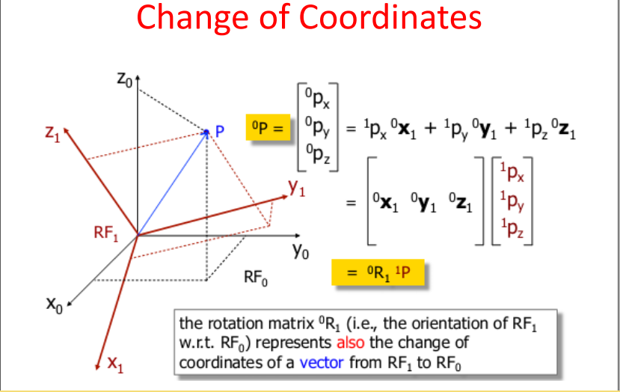

Slide 21
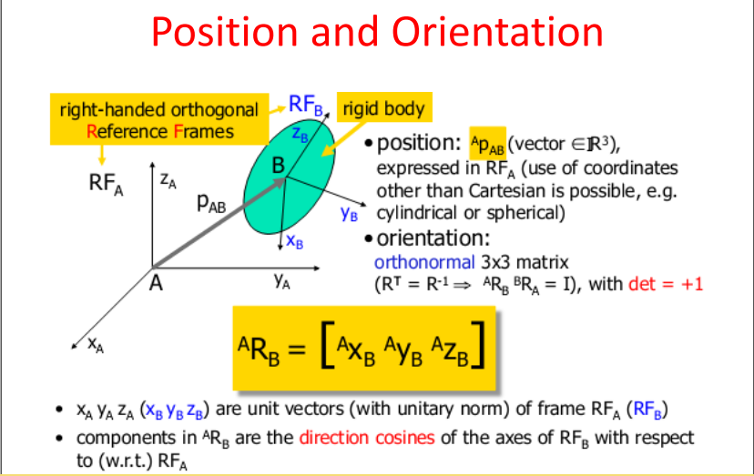

Slide 22
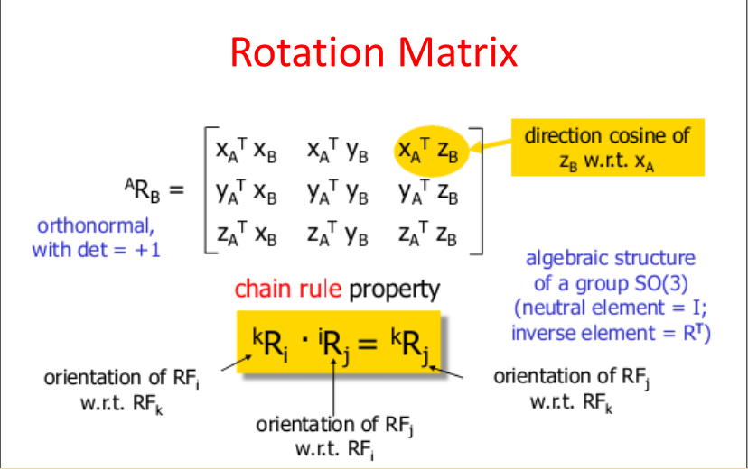

Slide 23
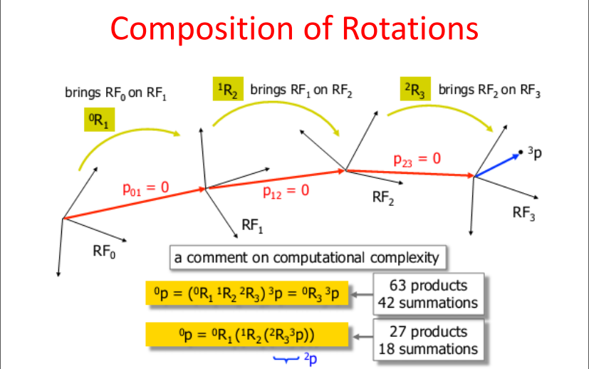

Slide 24
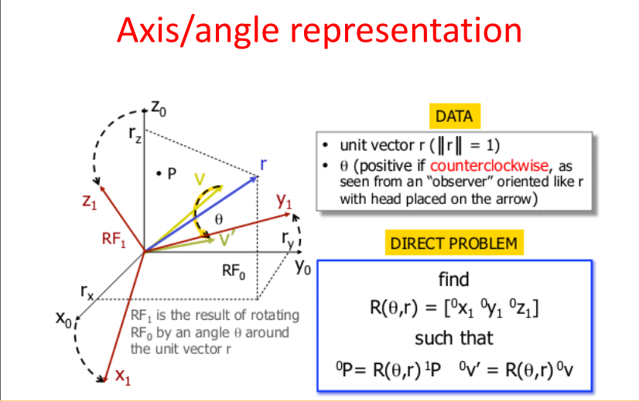

Slide 25
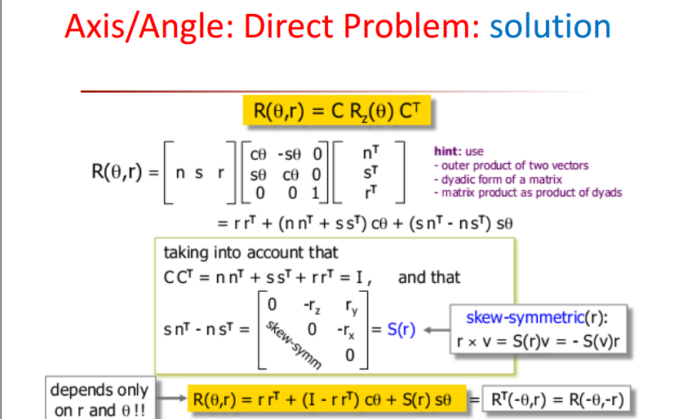

Slide 26
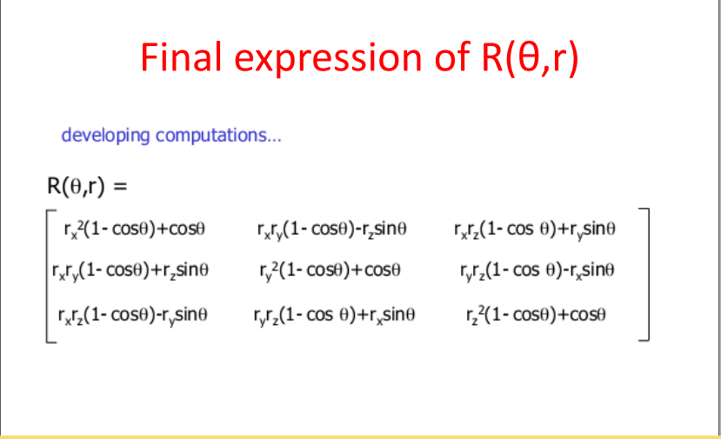

Slide 27
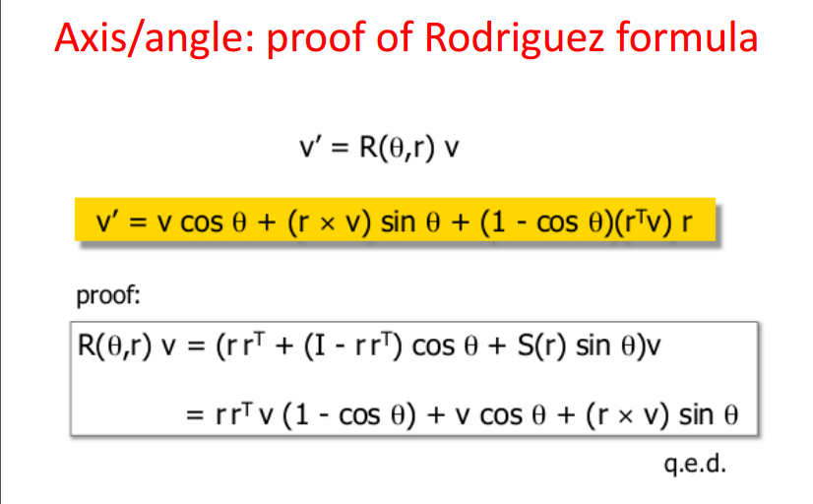

Slide 28
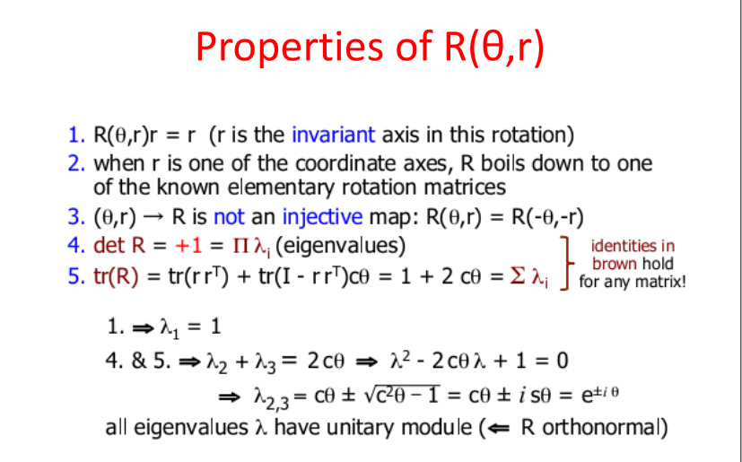

Slide 29
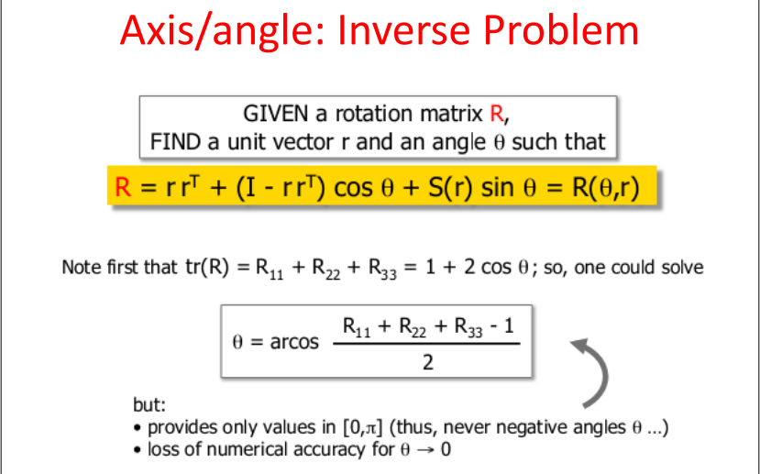

Slide 30
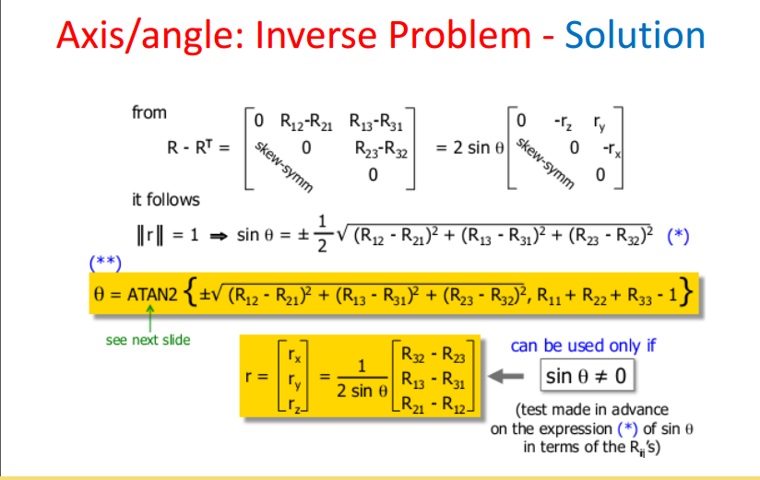

Slide 31
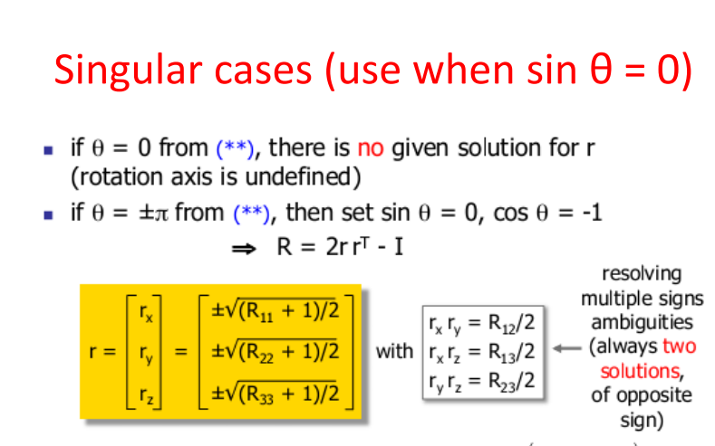

Slide 32
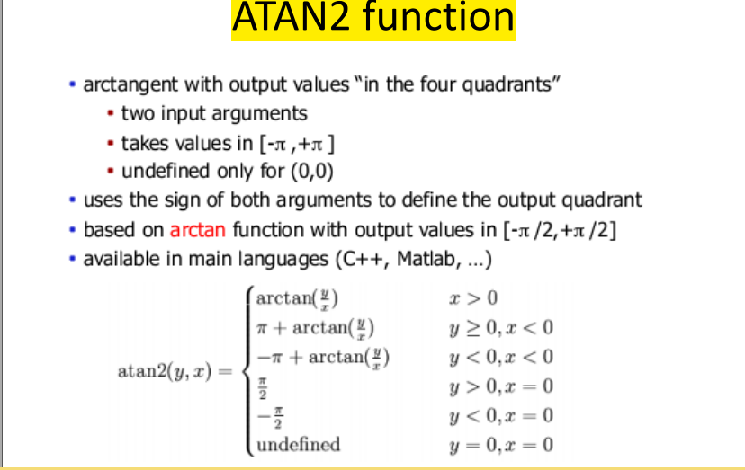

Slide 33
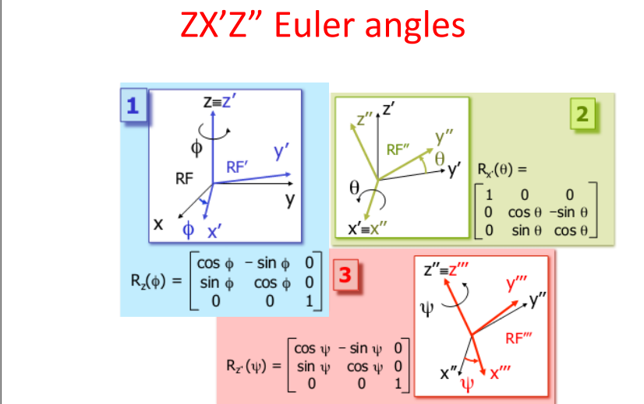

Slide 34
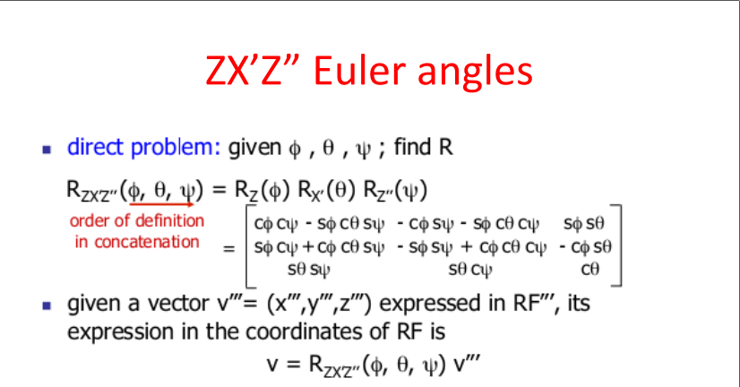

Slide 35
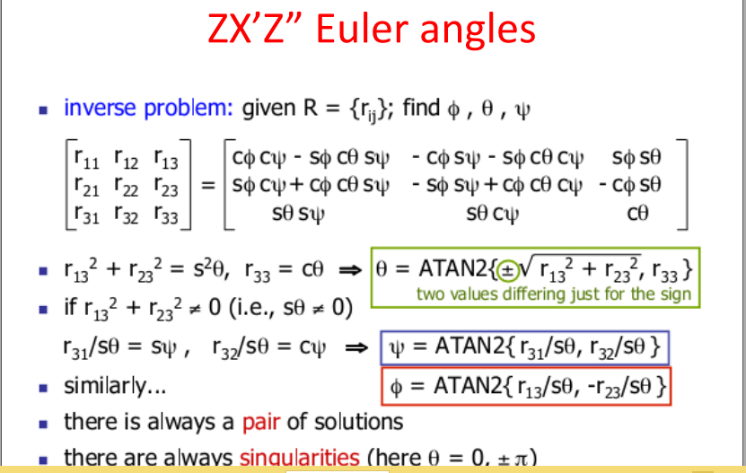

Slide 36
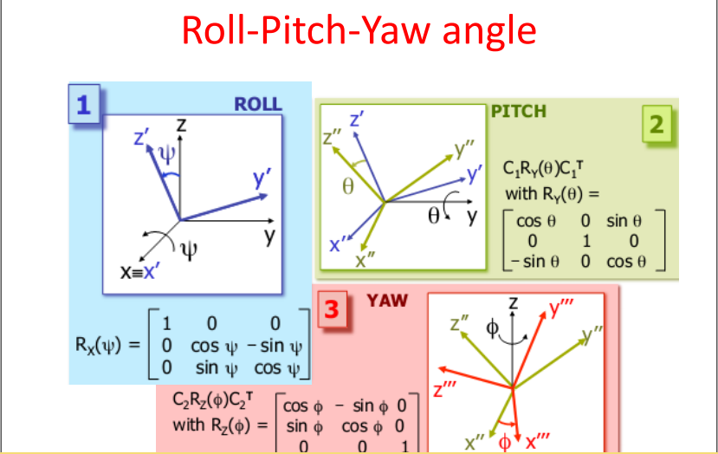

Slide 38
SOME PROGRAMMING IDEAS
… our project

Slide 39
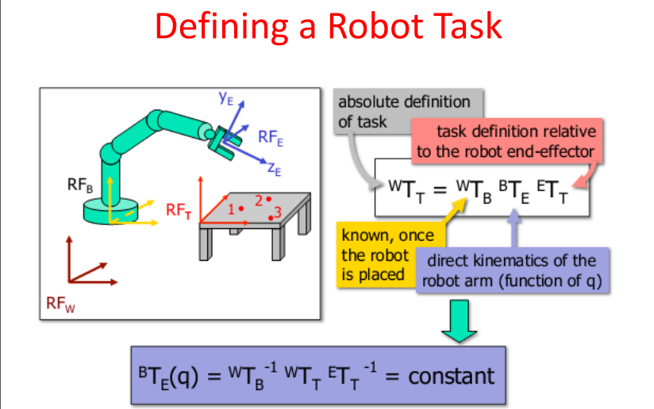

Slide 40
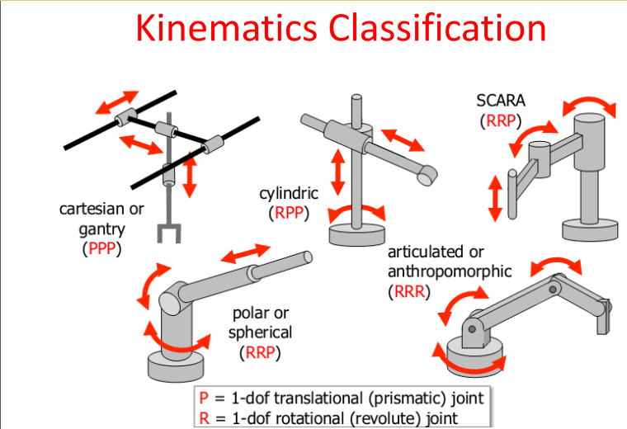

Slide 41
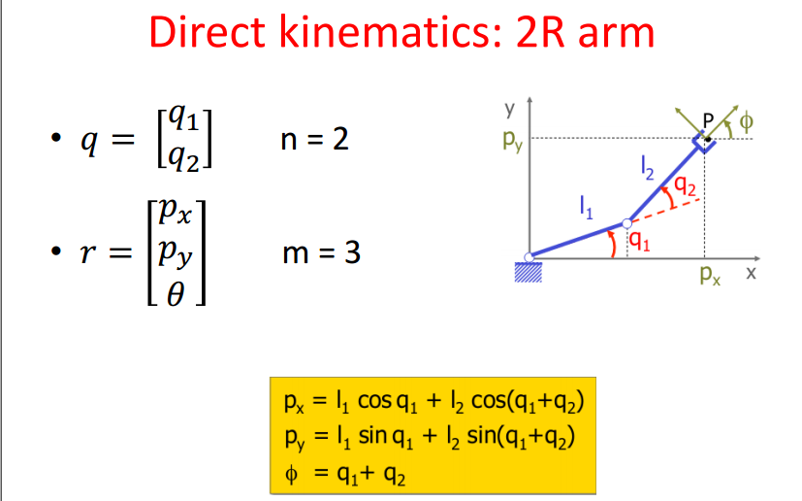

Slide 42
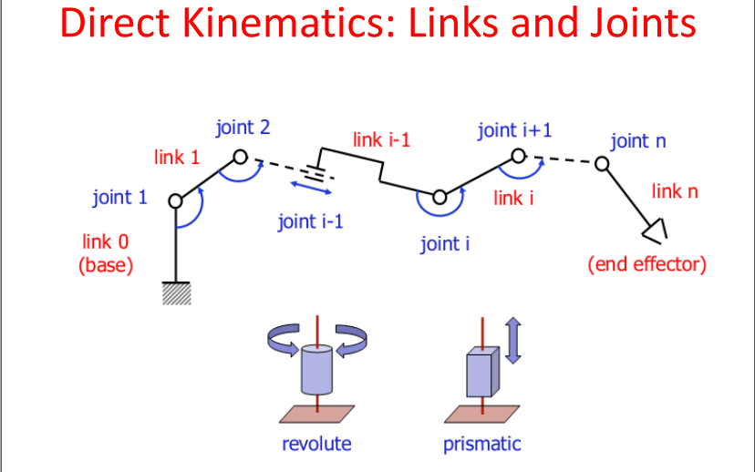

Slide 43
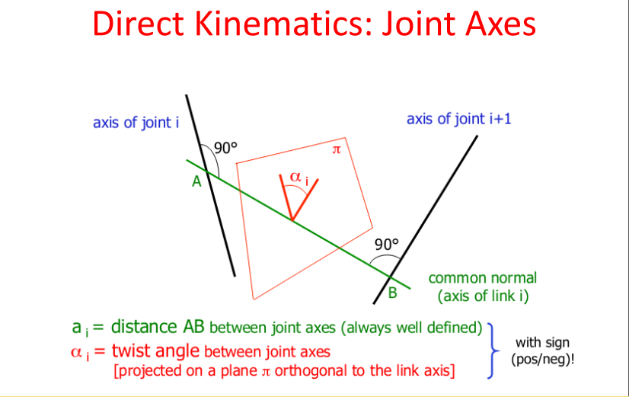

Slide 44
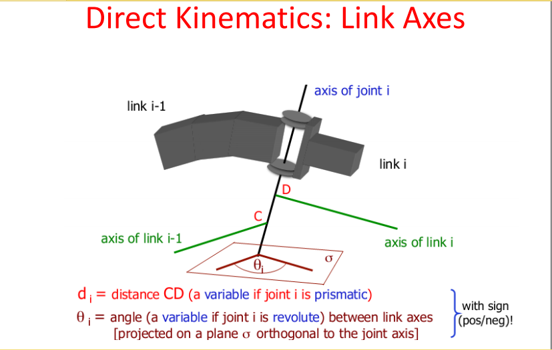

Slide 45
REFERENCES
Than, L. D. (n.d.). Case Study
http://arduino.cc
http://labcenter.com
http://arduino.vn
http://wikipedia.com

